Slide 1
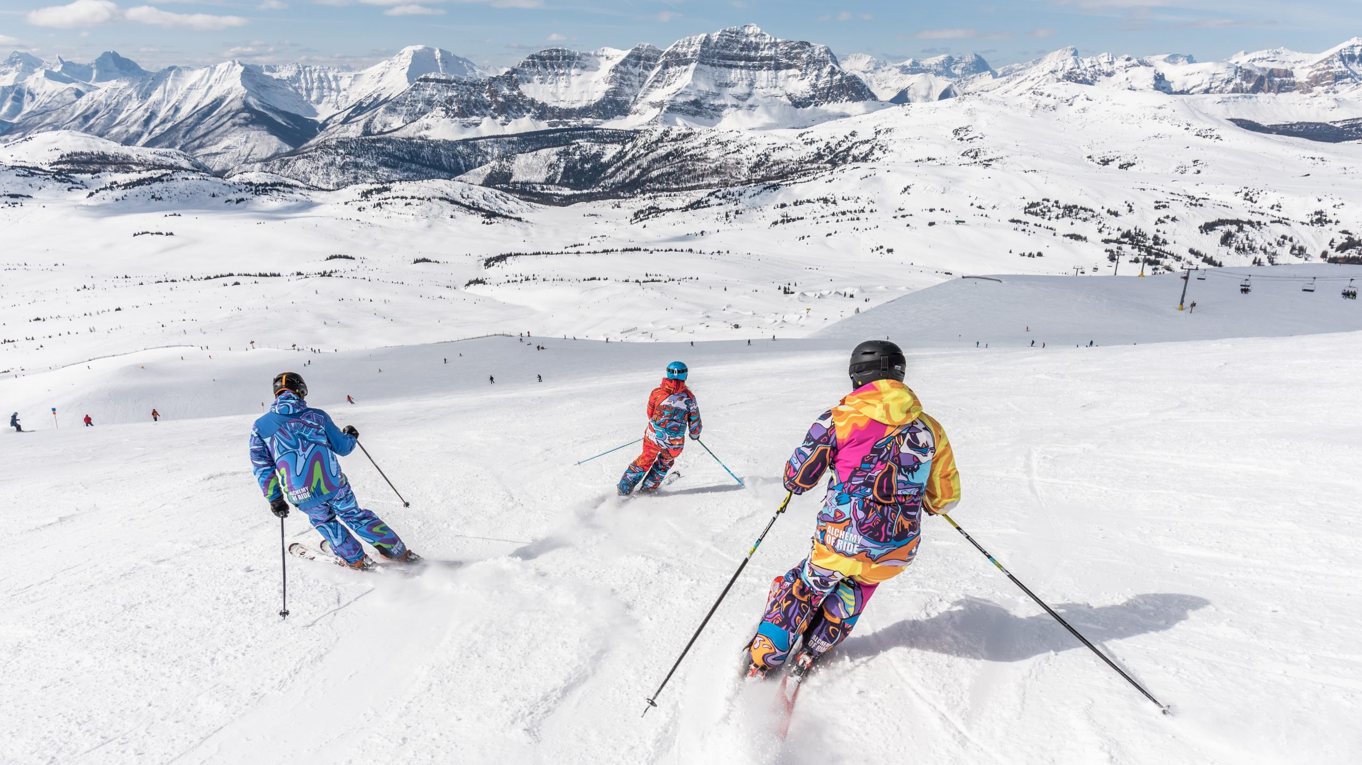
European Ski Resorts

Slide 2
DATA SOURCE
Description
The datasets were retrieved from Kaggle. This was further cleaned to enhance the accuracy of the data generated. The data is a comprehensive list of various ski resorts in different countries.
Each resort is accompanied by details such as the country it is located in, its highest and lowest points, day pass prices for adults, information on the slopes (beginner, intermediate, difficult), total number of slopes, presence of snowparks, night skiing availability, and information about lifts (surface lifts, chair lifts, gondola lifts, and total lifts).
The data was analyzed to help answer the research questions posed and draw some assumptions and conclusions
Kaggle Dataset 1: Ski Resorts Worldwide (kaggle.com)

Slide 3
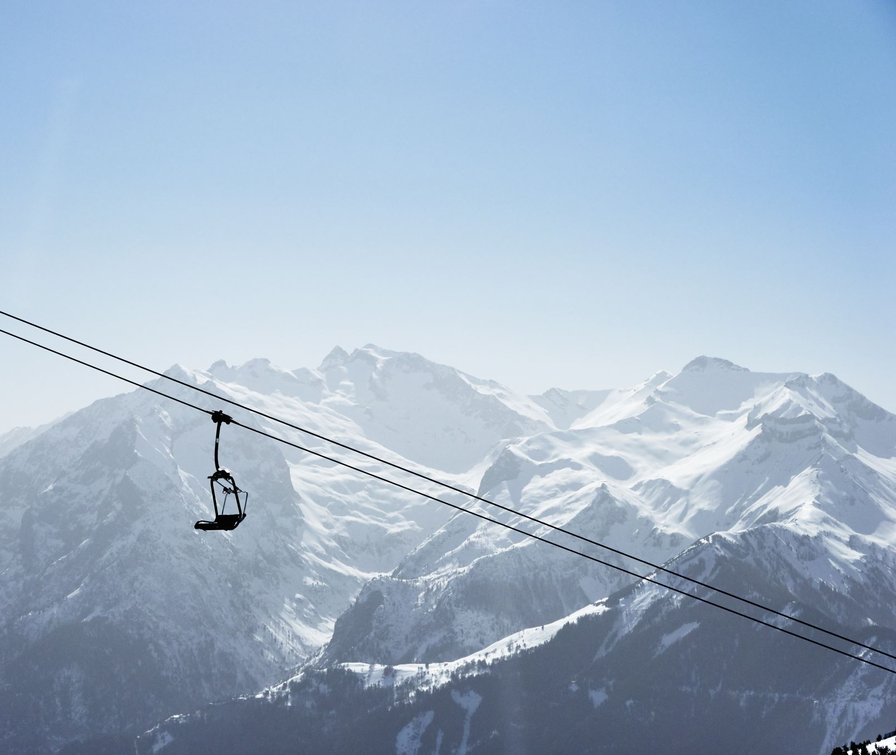
DID YOU KNOW ?
Skiing is a long-standing European tradition. It first appeared in Scandinavia about 4,000 years ago as a mode of transportation.
Today, skiing tourism plays a key socioeconomic role in Europe.
For ski enthusiasts, the most crucial aspect of the location is the quality of the ski resorts.

Slide 4

RESEARCH QUESTION
What resort is within my budget?
What will the weather be like?
How does the distance of the ski slope compare to price ?
What is it rated by other skiers?

Slide 5
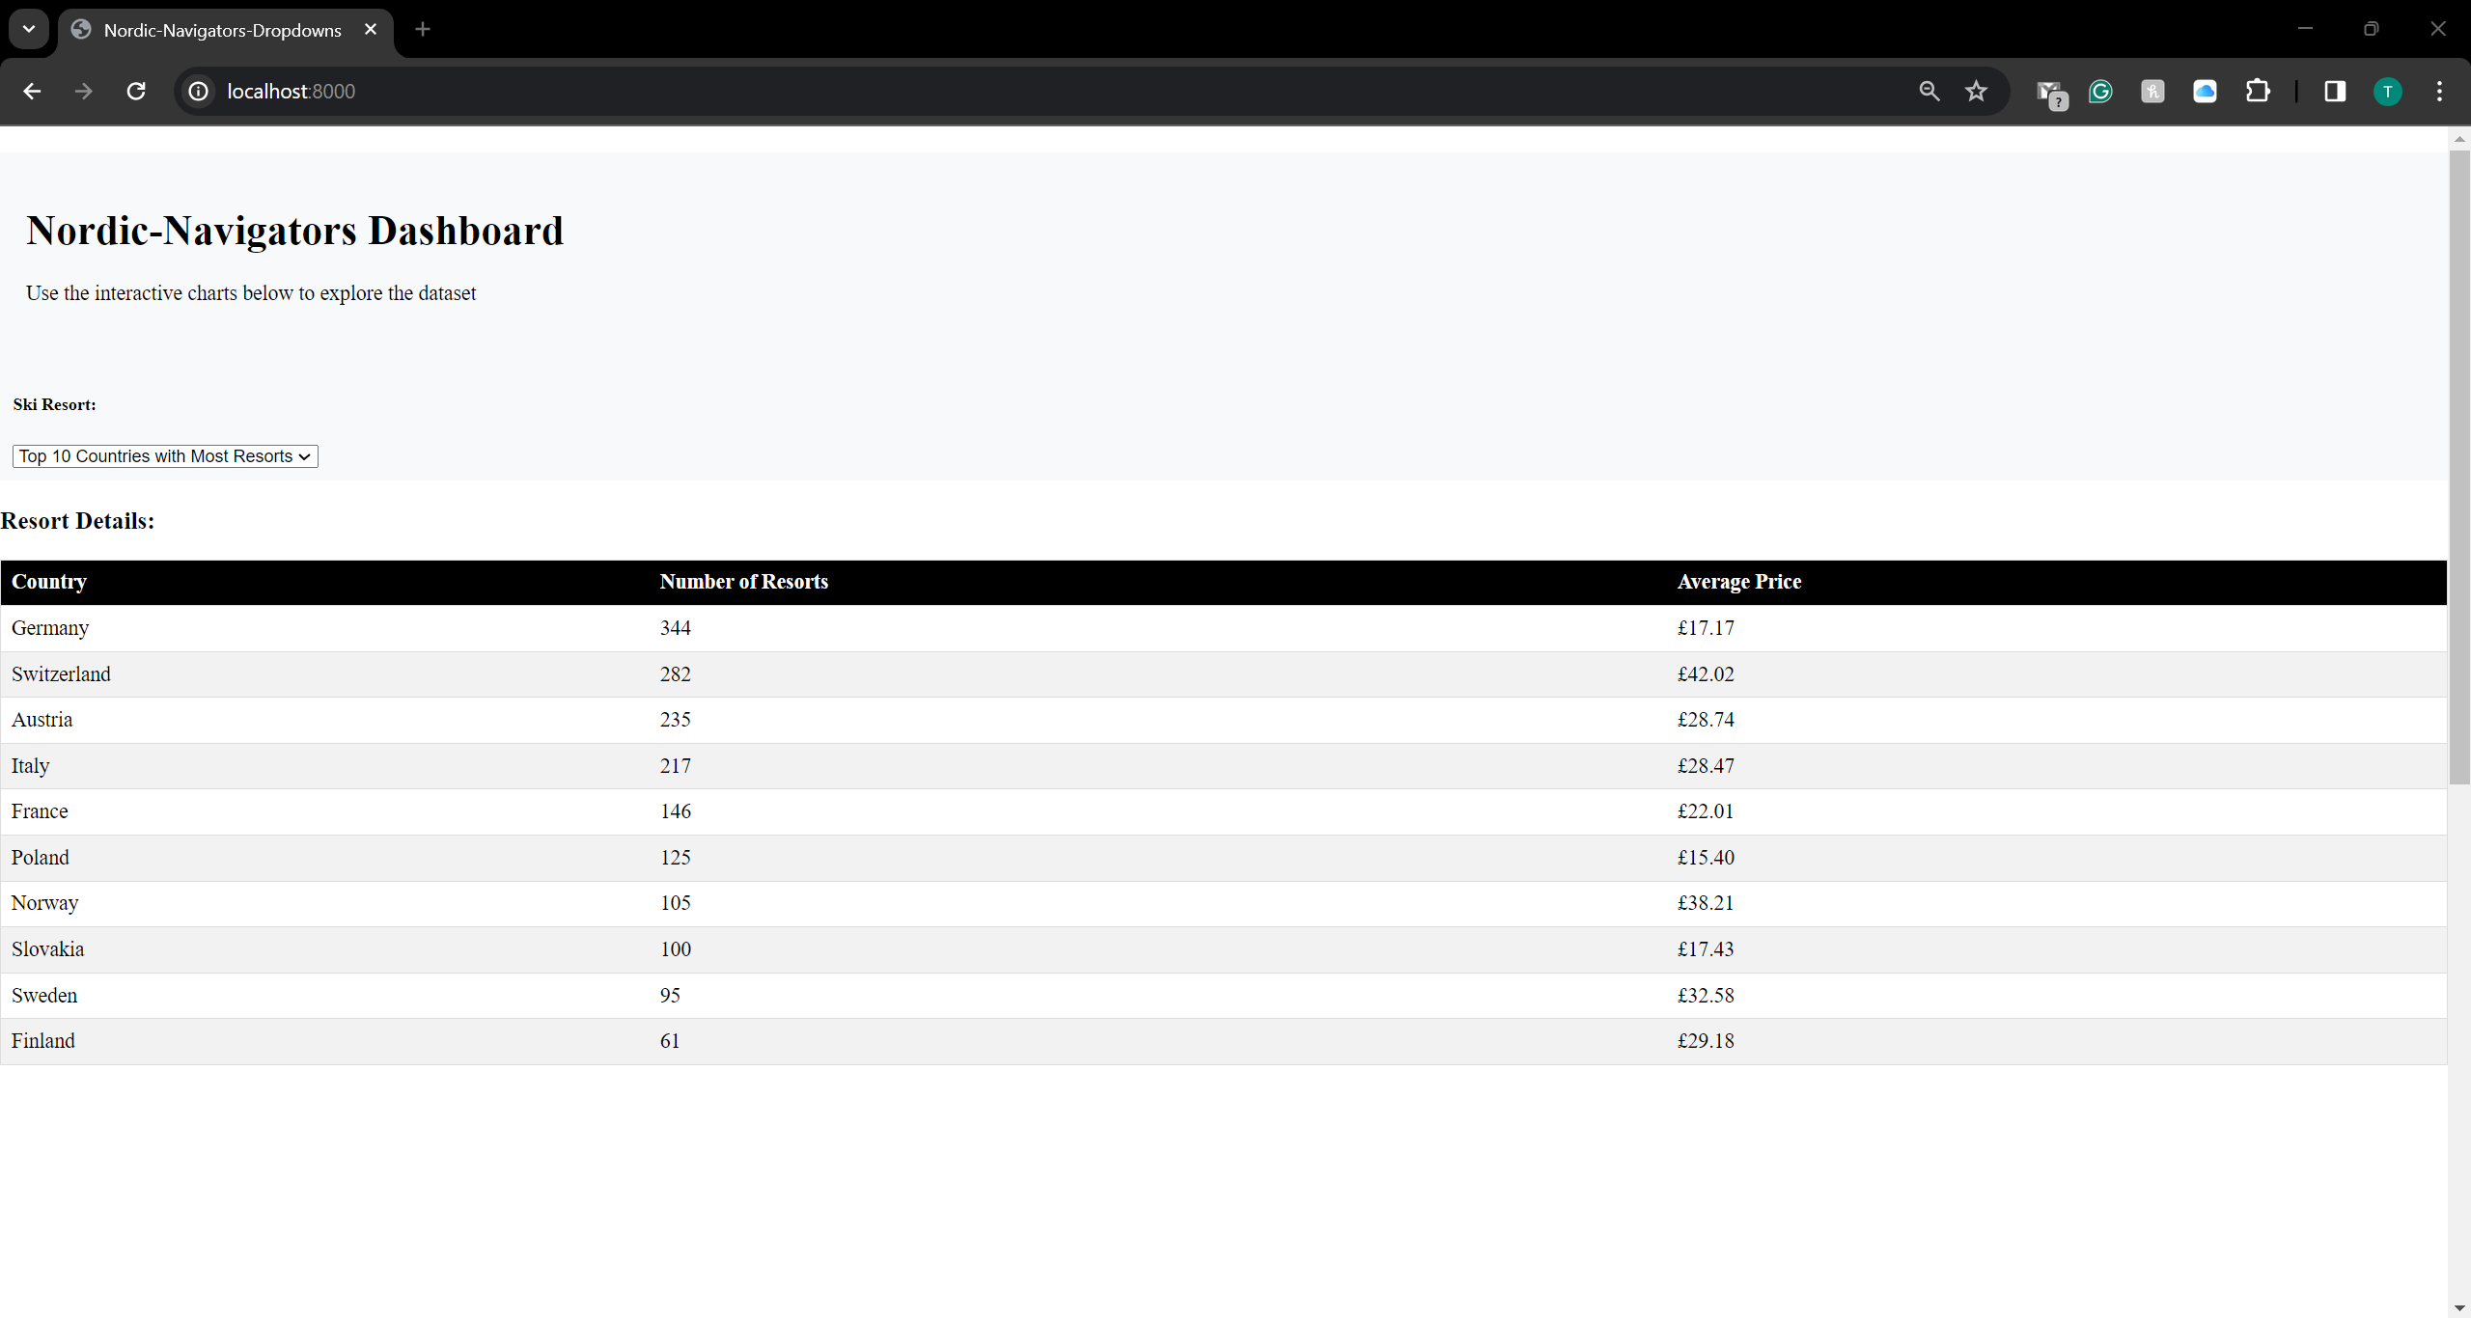
Average price per resorts

Slide 6
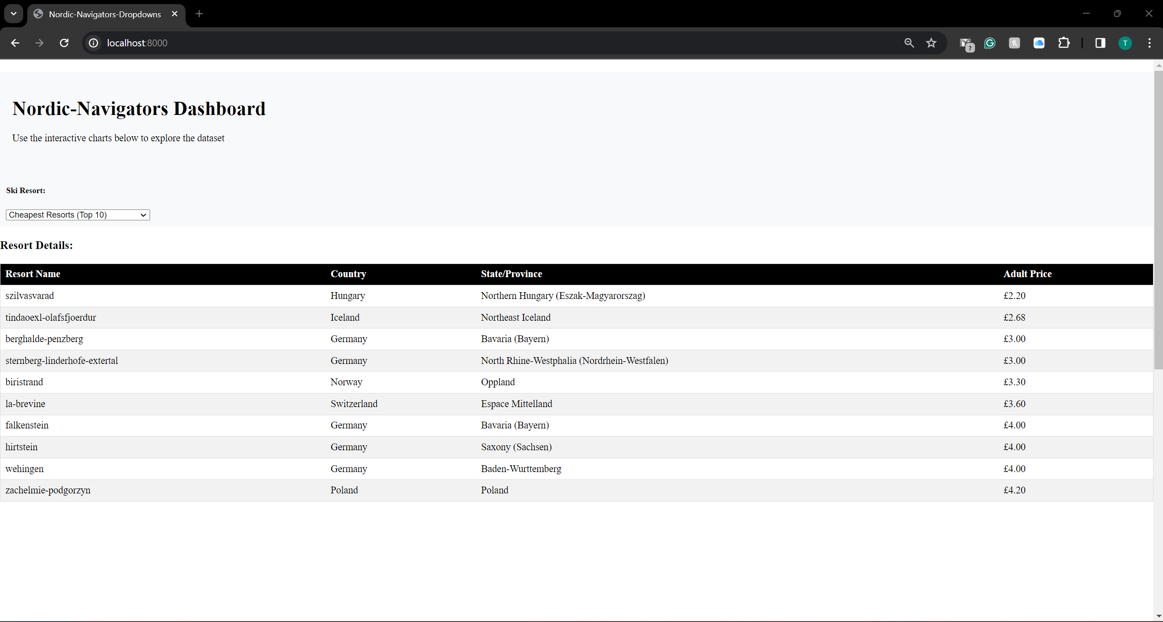
CHEAPEST RESORTS

Slide 7
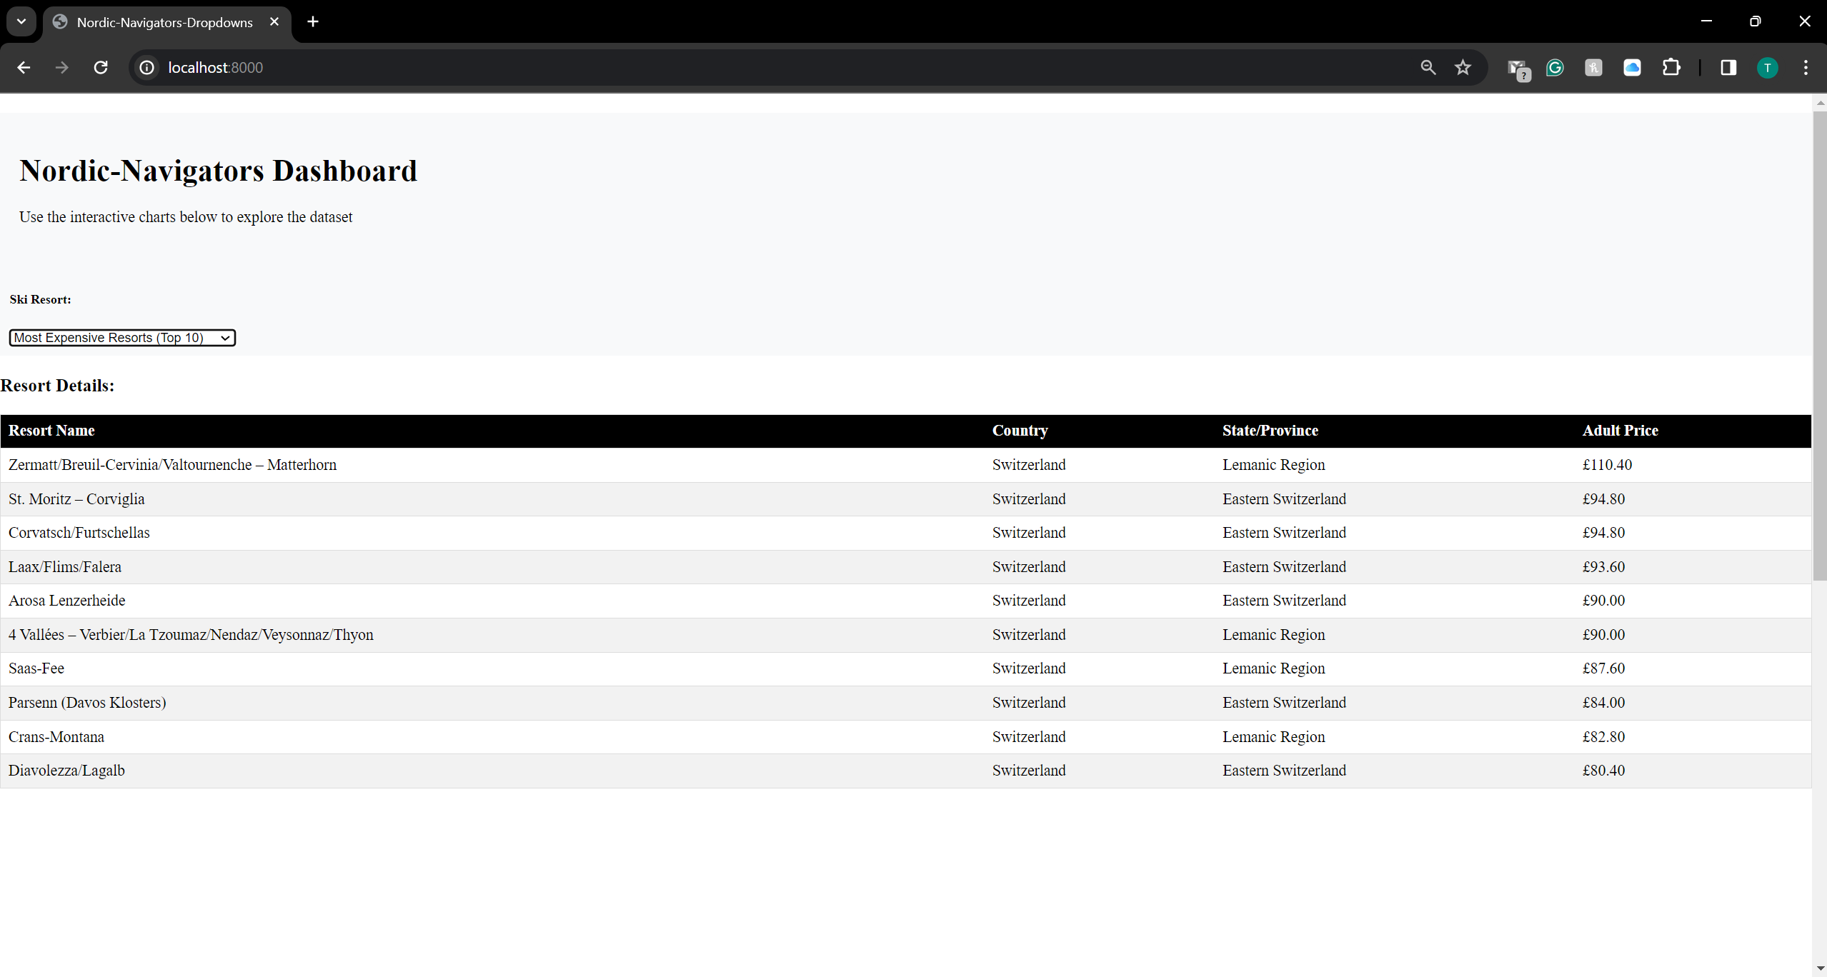
Most expensive resorts

Slide 8
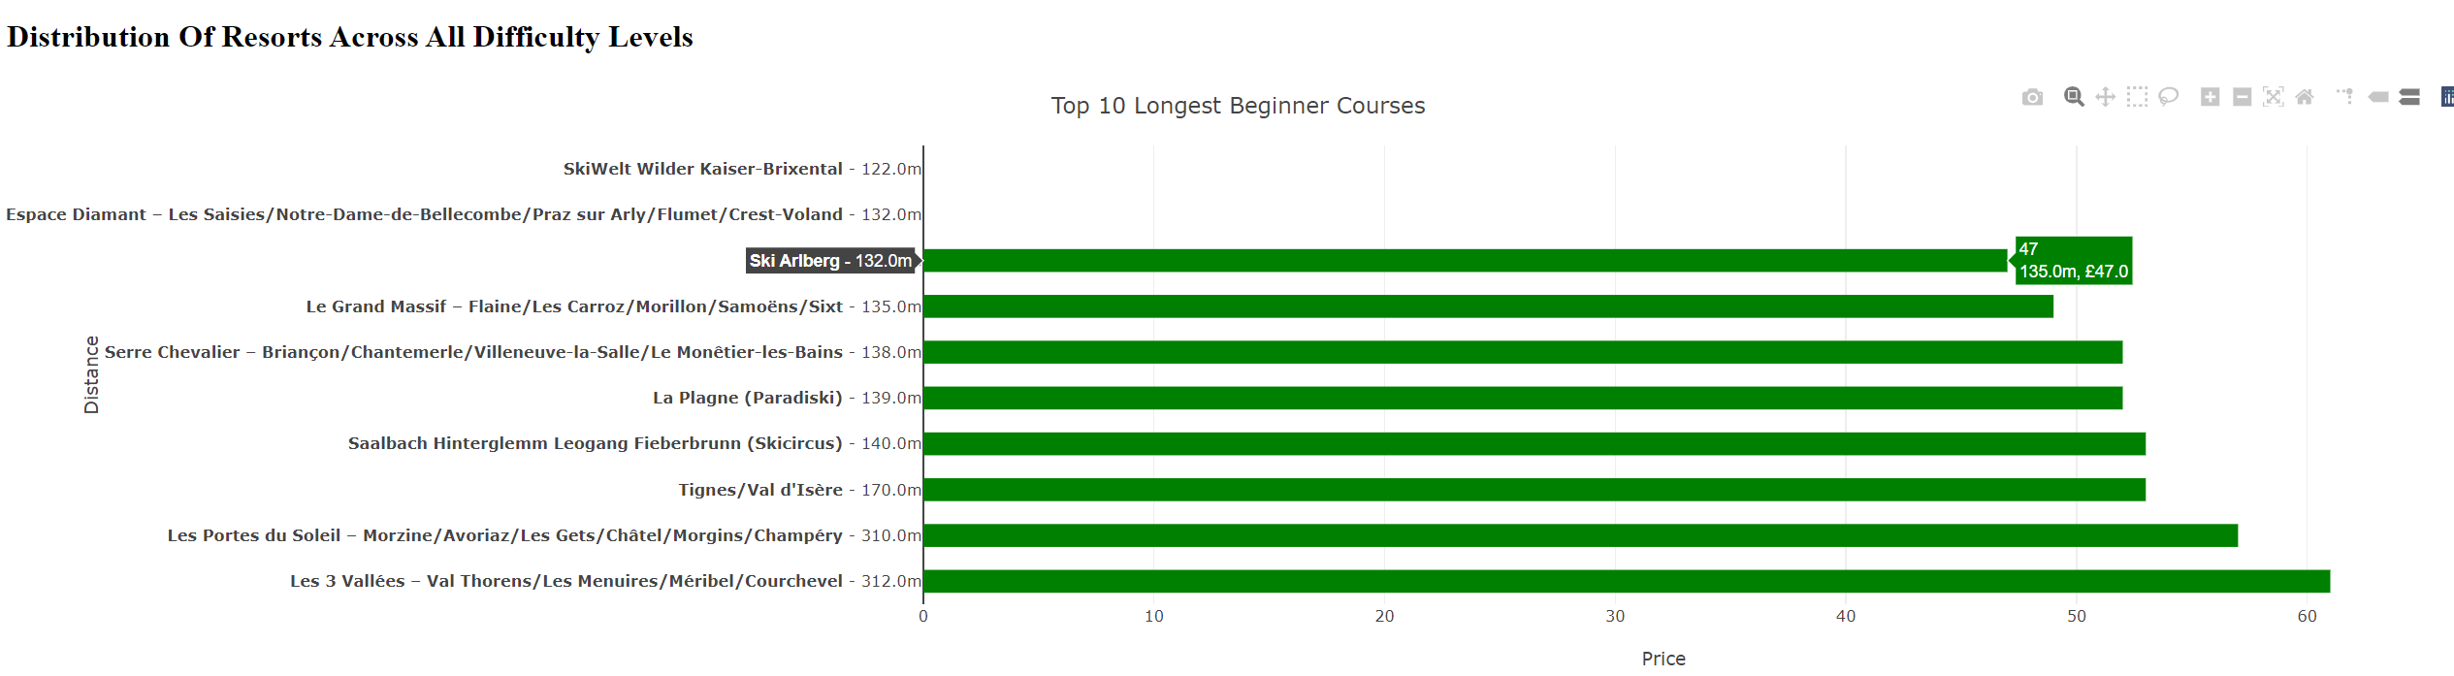
SKILL LEVEL

Slide 9
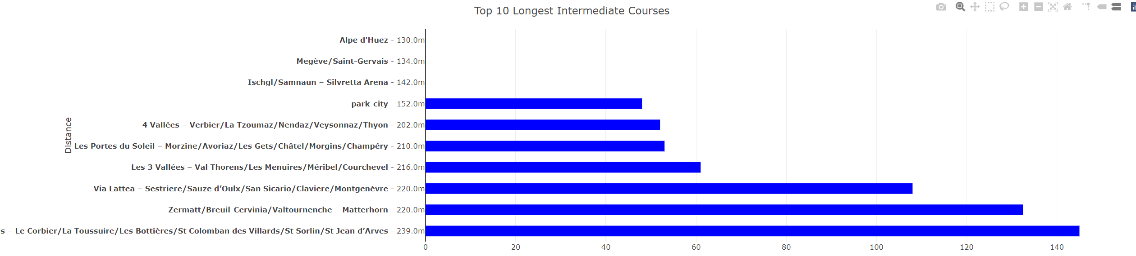
SKILL LEVEL

Slide 10
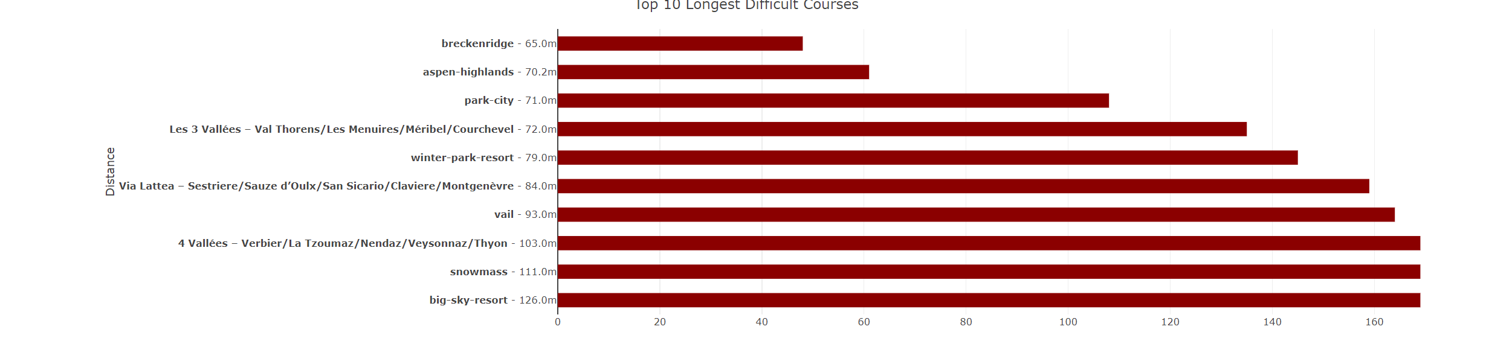
SKILL LEVEL

Slide 11
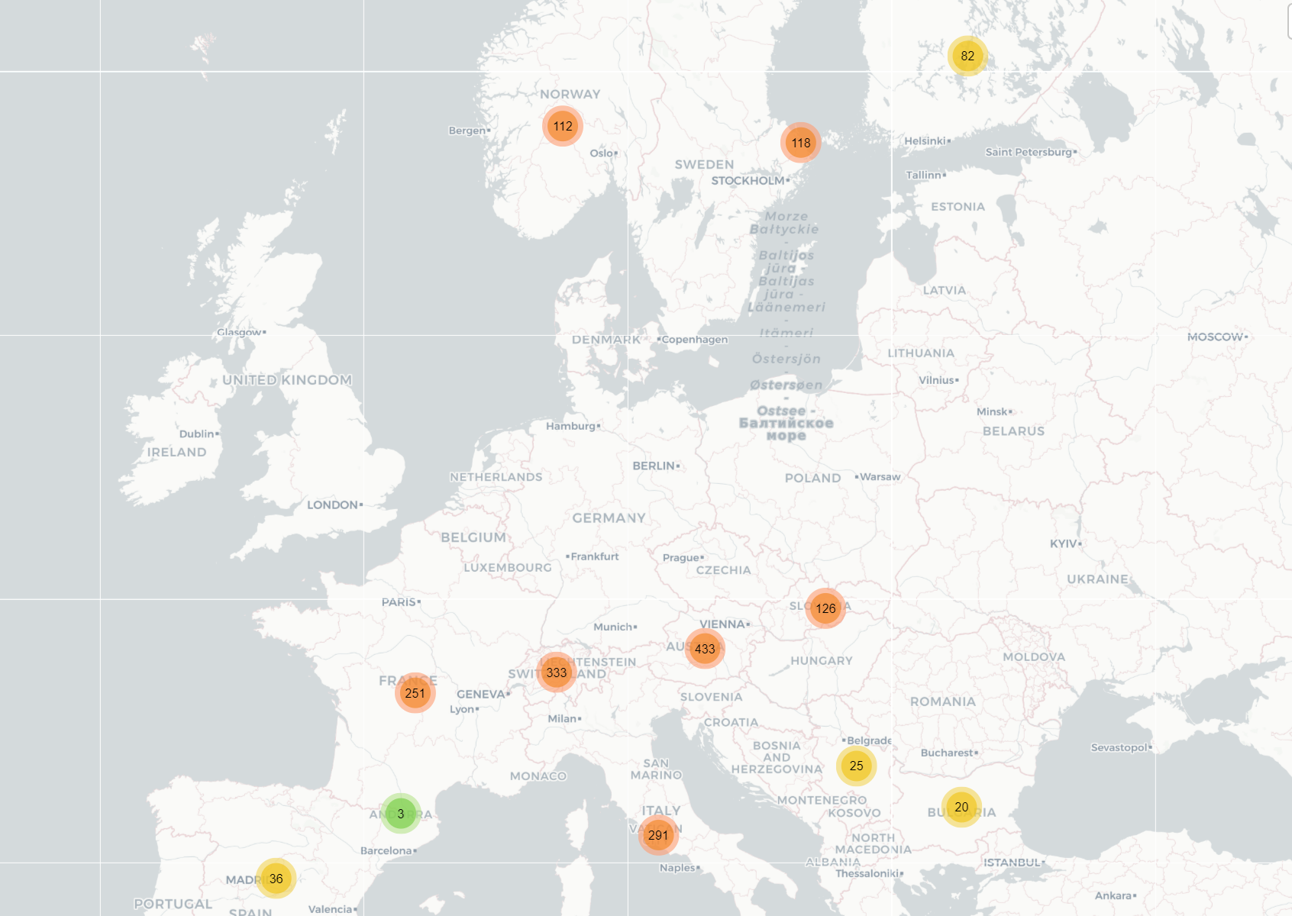
Leaflet Map

Slide 12

Questions?

